Slide 1
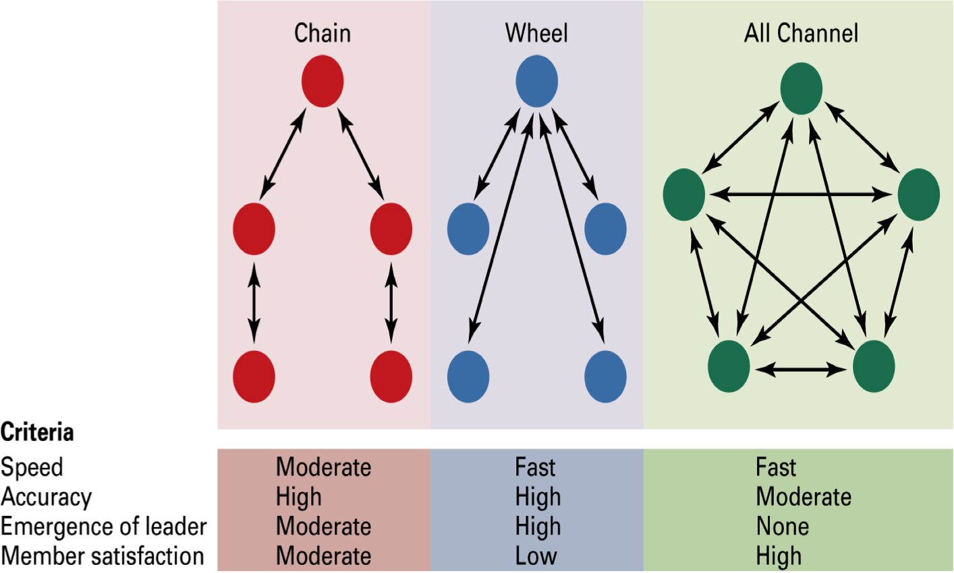
Three common communication networks & performance

Slide 2
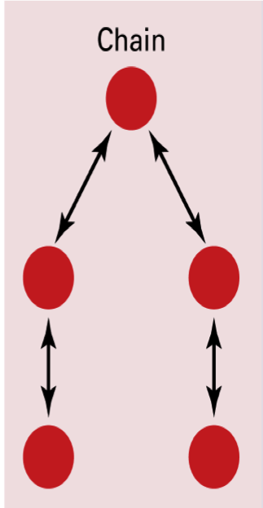
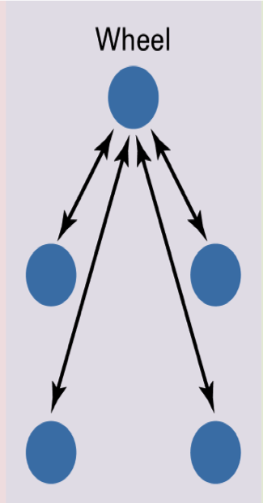
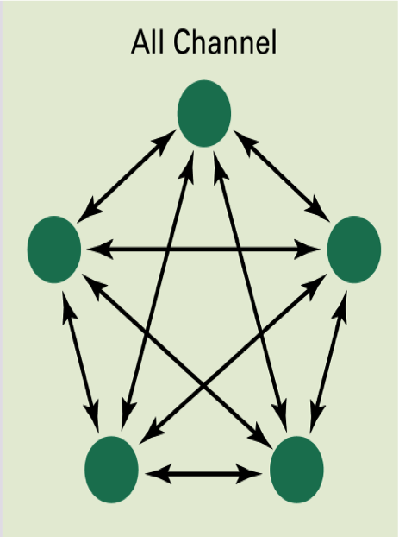
Experiment
Group 1
Group 2
Group 3
Group 4
Notes:
Group 1: sit in a line
Group 2: 4 people at each corner of the room

Slide 3
 |  | SCORE |  |  | SCORE
Group 1 | Ind 1 |  |  | Group 1
 | Ind 2
 | Ind 3
 | Ind 4
 | Ind 5
Group 2 | Ind 1 |  |  | Group 2
 | Ind 2
 | Ind 3
 | Ind 4
 | Ind 5
Group 3 | Ind 1 |  |  | Group 3
 | Ind 2
 | Ind 3
 | Ind 4
 | Ind 5
Group 4 | Ind 1 |  |  | Group 4
 | Ind 2
 | Ind 3
 | Ind 4
 | Ind 5

Slide 4
In general, centralized structures are more efficient:
  have an obvious leader; no time wasted in searching for a strategy; everyone funnels all info to the leader
Later experiments found that…
  Centralized structure is better for simple tasks
  Decentralized structure is better for complex/ambiguous tasks; when information is distributed unevenly among group members
  In high-stress condition, centralized structure emerges
The effect of external ties
  Information flow (weak ties for bringing in simple information; strong ties required for complex information and tacit knowledge)
  Shared external ties limit opportunistic behavior

